Slide 1

Experiential Learning Project Assessment-I on
“Tie Tac Toe Game.”
under the course
Python Programming Language (N-PCCCM304P)
Presented By: Aarushi Jambhulkar [CM25001]
Under the Guidance of
Mrs. Mayuri Getme
Session:2026-27 (ODD )
Department of CSE(AI&ML)
S. B. JAIN INSTITUTE OF TECHNOLOGY MANAGEMENT AND
RESEARCH,NAGPUR
An Autonomous Institute, Affiliated to RTMNU, Nagpur
)

Slide 2
Contents
Problem statement
Objectives
Algorithm
Flowchart/pseudocode
Understanding of Python logic
GitHub account, repository creation, uploading code, meaningful commits, collaboration, individual contribution
S. B. Jain Institute of Technology Management and research

Slide 3
1. Problem Statement
Traditional Tic Tac Toe requires a clear board and rule-based turn management.
Players need an interactive way to enter moves and see the current game state.
Invalid inputs, such as occupied or out-of-range positions, must be handled safely.
The program must determine whether X or O wins after every valid move.
If all nine positions are filled without a winner, the game should declare a draw.
The project should allow a new game after completion.
The aim is to demonstrate practical Python logic through a simple, user-friendly game.

Slide 4
2. Objective
To develop a Python-based Tic Tac Toe game using a 3×3 grid. To allow two players to play alternately using X and O.
To validate user input and prevent invalid or repeated moves.
To implement winner detection using rows, columns and diagonals.
To identify draw conditions when the board becomes full.
To provide an option to start a new game.
To understand and apply core Python concepts such as lists, loops, functions and conditional statements.
To practice GitHub-based version control and collaboration.
. □

Slide 5
3. Algorithm
Start the program.
Create a 3×3 board with empty positions.
Set the current player as X.
Display the board and ask the player for a valid position.
Place the player's symbol in the selected empty position.
Check all rows, columns and diagonals for a winning combination.
If a winner is found, display the winner and end the game.
If the board is full without a winner, display Draw and end the game.
Otherwise switch the player from X to O or O to X and repeat.
Offer the option to start a new game.
.

Slide 6
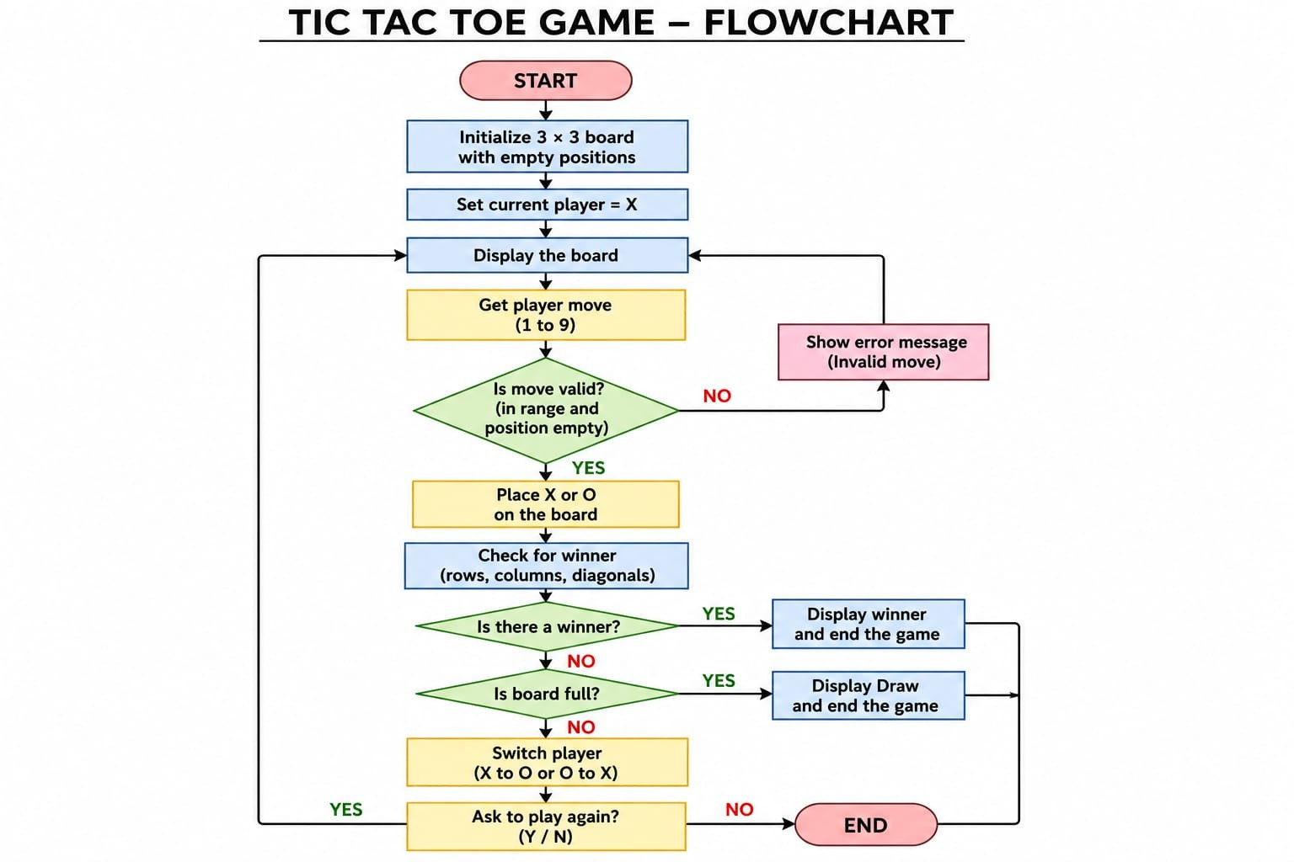
4. Flowchart

Slide 7

5. Understanding of python logic
board = [" "] * 9
winning = [
Functions organize tasks such as display_board(), get_move() and check_winner().
while loops keep the game running until a winner or draw occurs.
if / elif / else handle validation, win conditions and draw conditions.
for loops check every possible winning combination.
Input is converted and validated before updating the board.
The current-player variable switches between X and O.
Lists represent the nine board positions.
(0,1,2), | (3,4,5), | (6,7,8),
(0,3,6), | (1,4,7), | (2,5,8),
(0,4,8), | (2,4,6)
]
for a, b, c in winning:
if board[a] == board[b] == board[c]
!= " ":
winner = board[a]

Slide 8
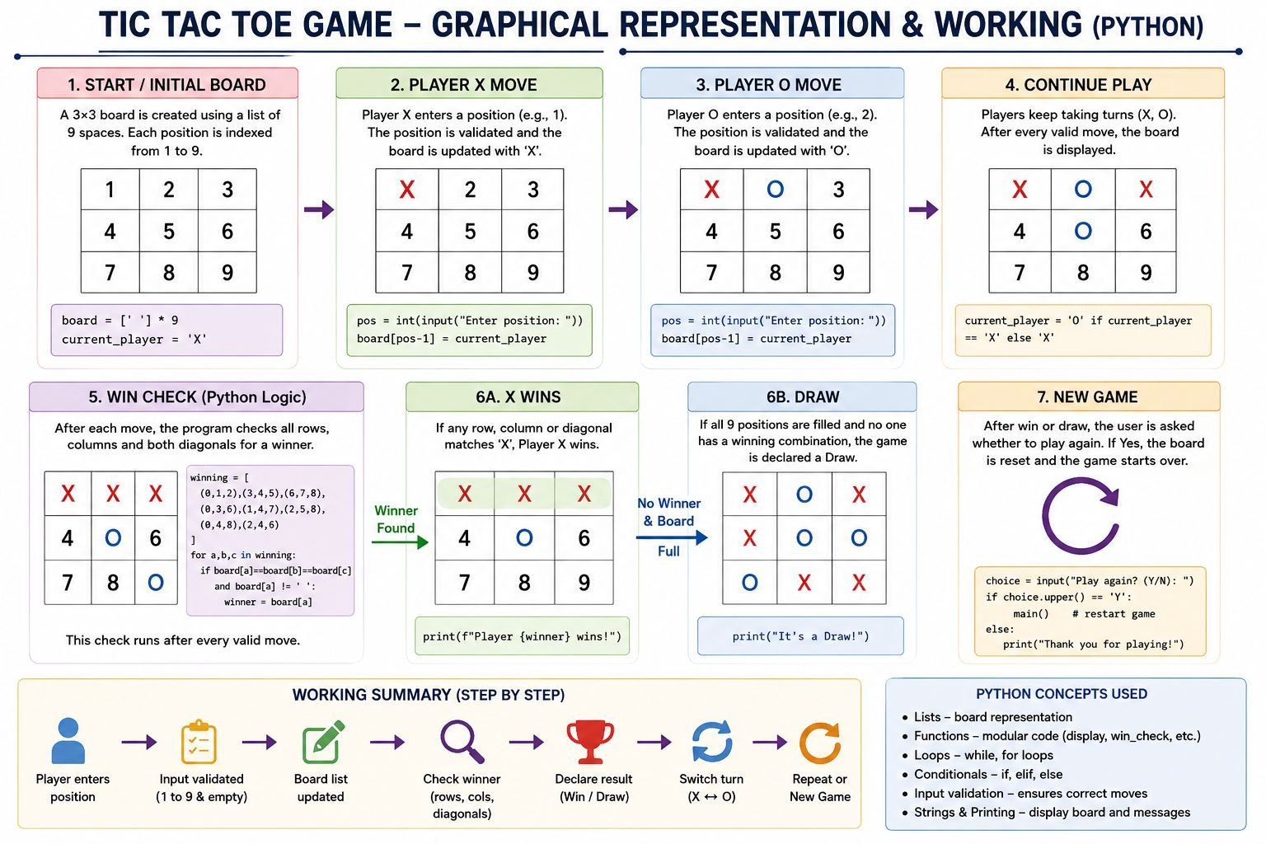
6. Graphical Representation and Working

Slide 9
7. GitHub Account, Repository & Collaboration
Create GitHub Account – Set up a personal GitHub account.
Create Repository – Tie Tac Toe Game.
Upload Code – Upload the Python project files.
Meaningful Commits – Save changes with clear commit messages.
Collaboration – For teamwork, use repository sharing, branches or pull
requests.
Individual Contribution – Each member contributes and commits their work.
Track Changes – Use GitHub to manage and track project updates.

Slide 10
8. Individual Contribution
Problem Analysis – Understood the requirements of the Tic Tac Toe game.
Algorithm Design – Designed the steps for turns, validation, winner detection and draw handling.
Python Coding – Implemented the game board and core game logic in Python.
Testing – Tested winning combinations, draw condition and invalid inputs.
GitHub Contribution – Created/managed the repository, uploaded code and made meaningful commits.
Documentation & PPT – Prepared project explanation, flowchart and presentation slides.

Slide 11
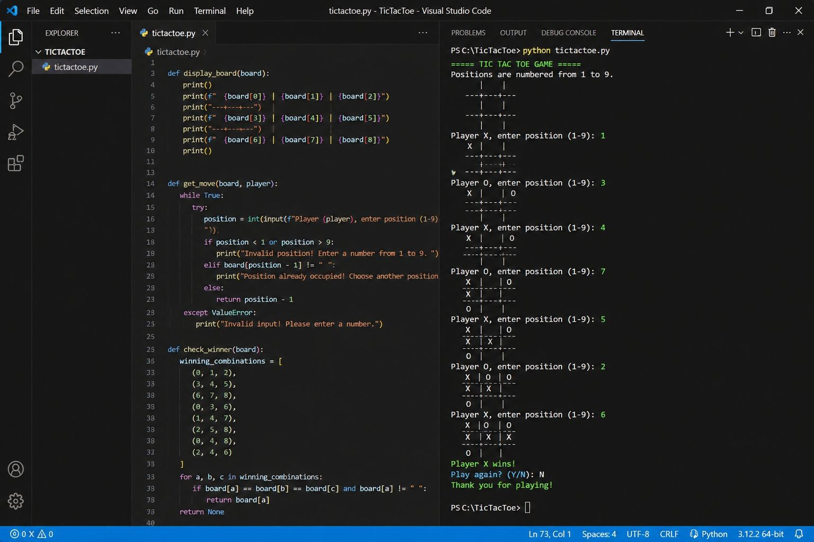
9. Result / Expected Output

Slide 12
Phase -2

Slide 13

PROBLEM STATEMENT
The basic Tic Tac Toe game provides two-player gameplay on a 3×3 board.
An enhanced version should provide more flexibility and a better user experience.
Players need safe input handling so invalid and repeated moves are rejected.
A computer mode can make the game playable without a second person.
The game should track results across multiple rounds using a scoreboard.
Users should be able to replay the game after a round is completed.
Therefore, Phase 2 enhances the project with Player vs Computer mode, validation, winner/draw checking, scoreboard, replay, and modular Python functions.

Slide 14
OBJECTIVES.
To provide Player vs Player and Player vs Computer modes.
To validate input and prevent invalid or occupied moves.
To develop a functional and interactive Tic Tac Toe game using Python.
To implement automatic winner and draw detection.
To maintain a scoreboard for multiple rounds.
To provide a replay option after each round.
To apply functions, lists, tuples, loops, conditional statements and exception handling.
To practice modular programming and GitHub-based version control.

Slide 15
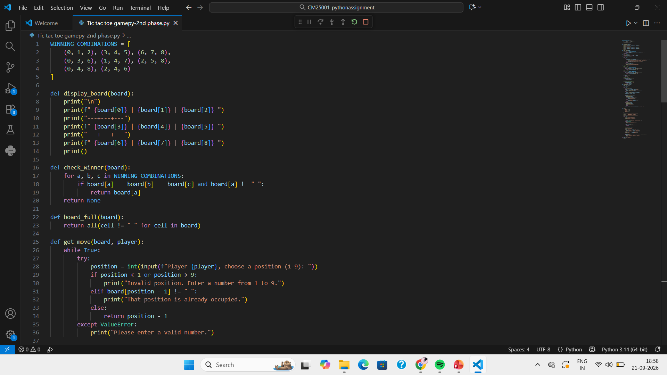
PYTHON TIC-TAC-TOE GAME CODE

Slide 16
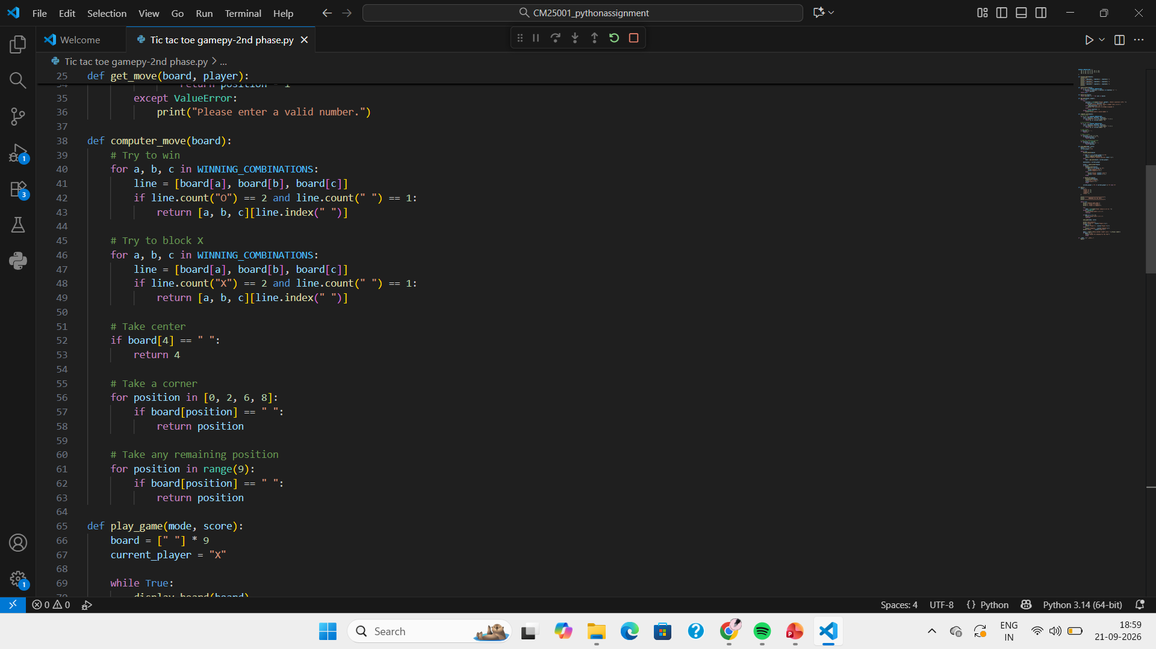
PYTHON TIC-TAC-TOE GAME CODE

Slide 17
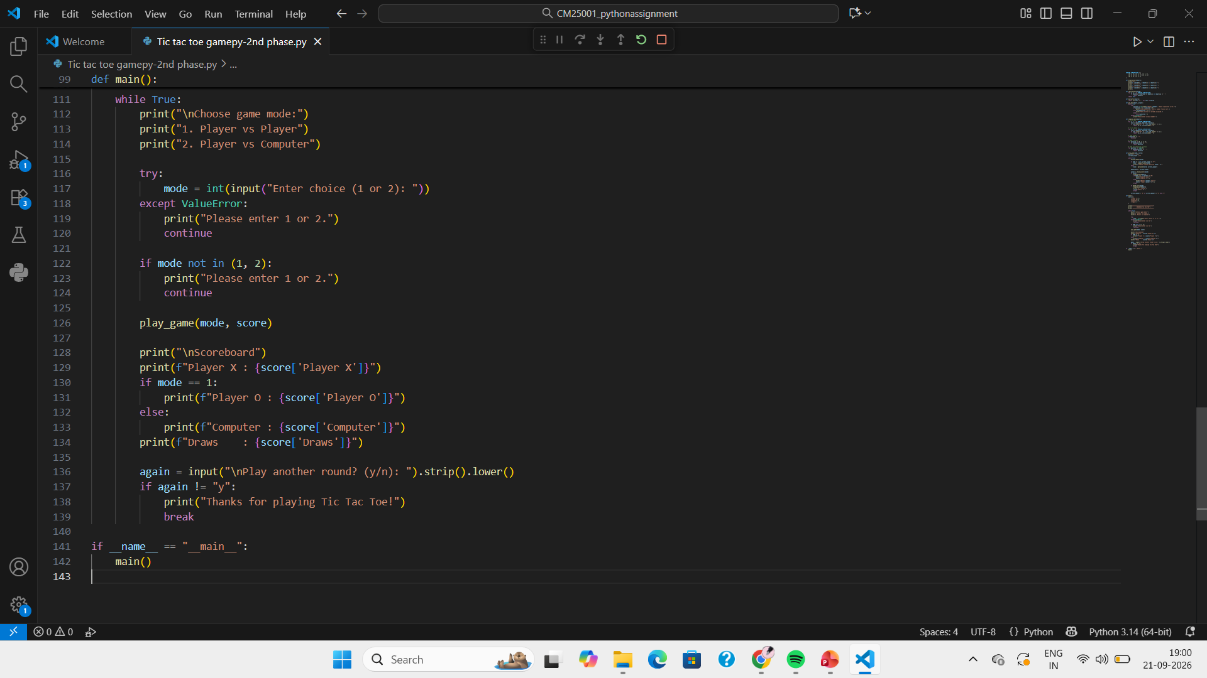
PYTHON TIC-TAC-TOE GAME CODE

Slide 18
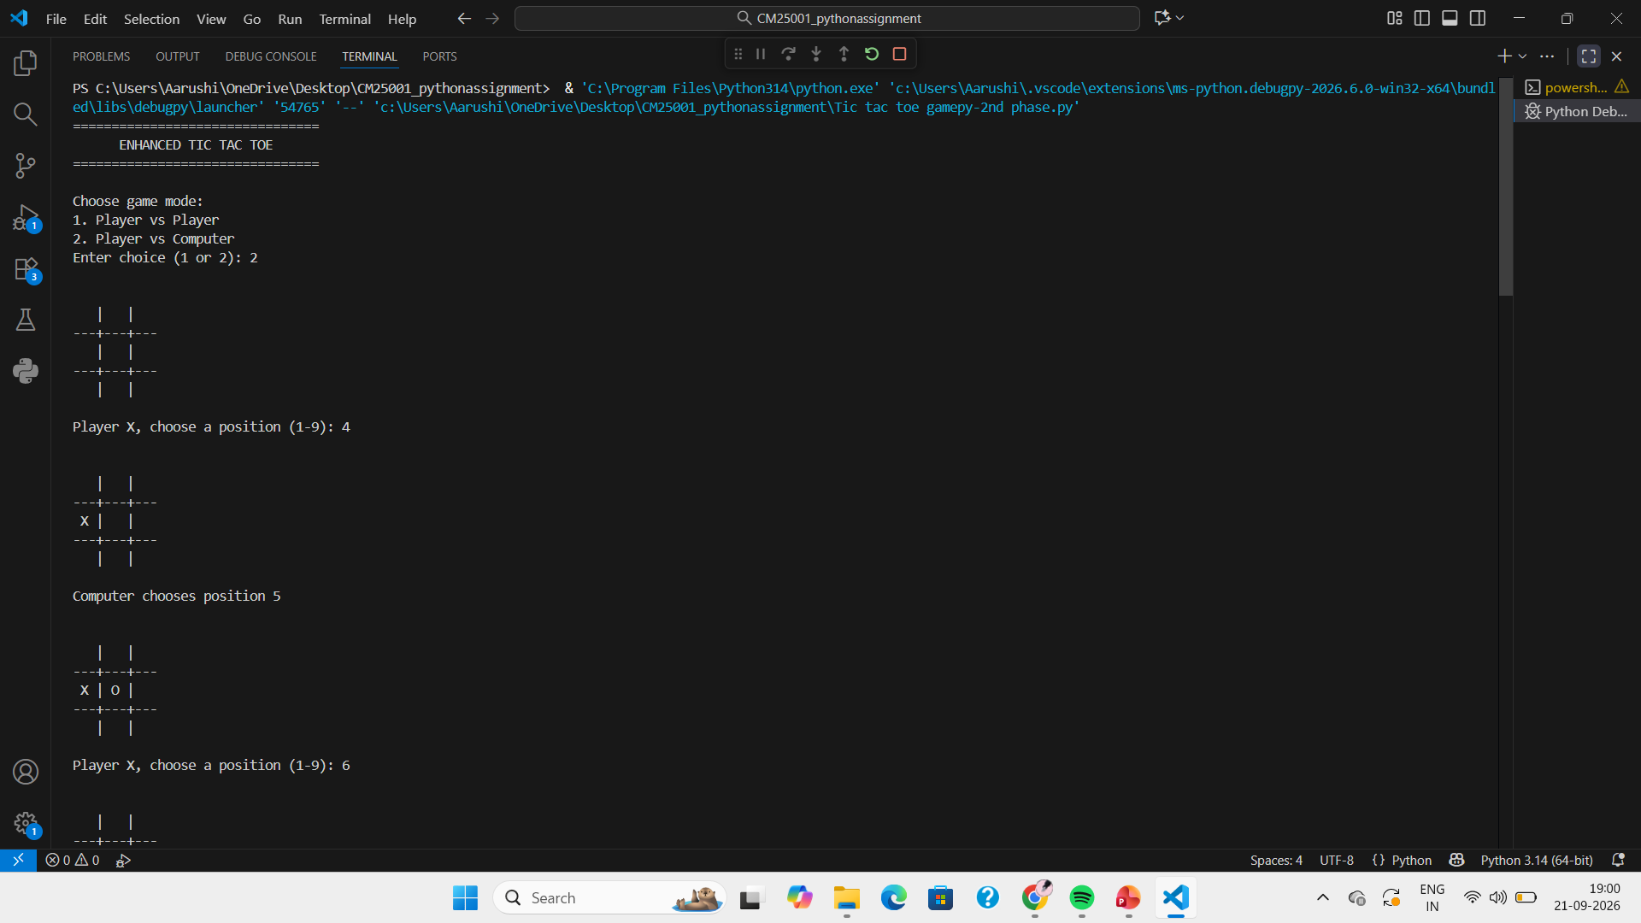
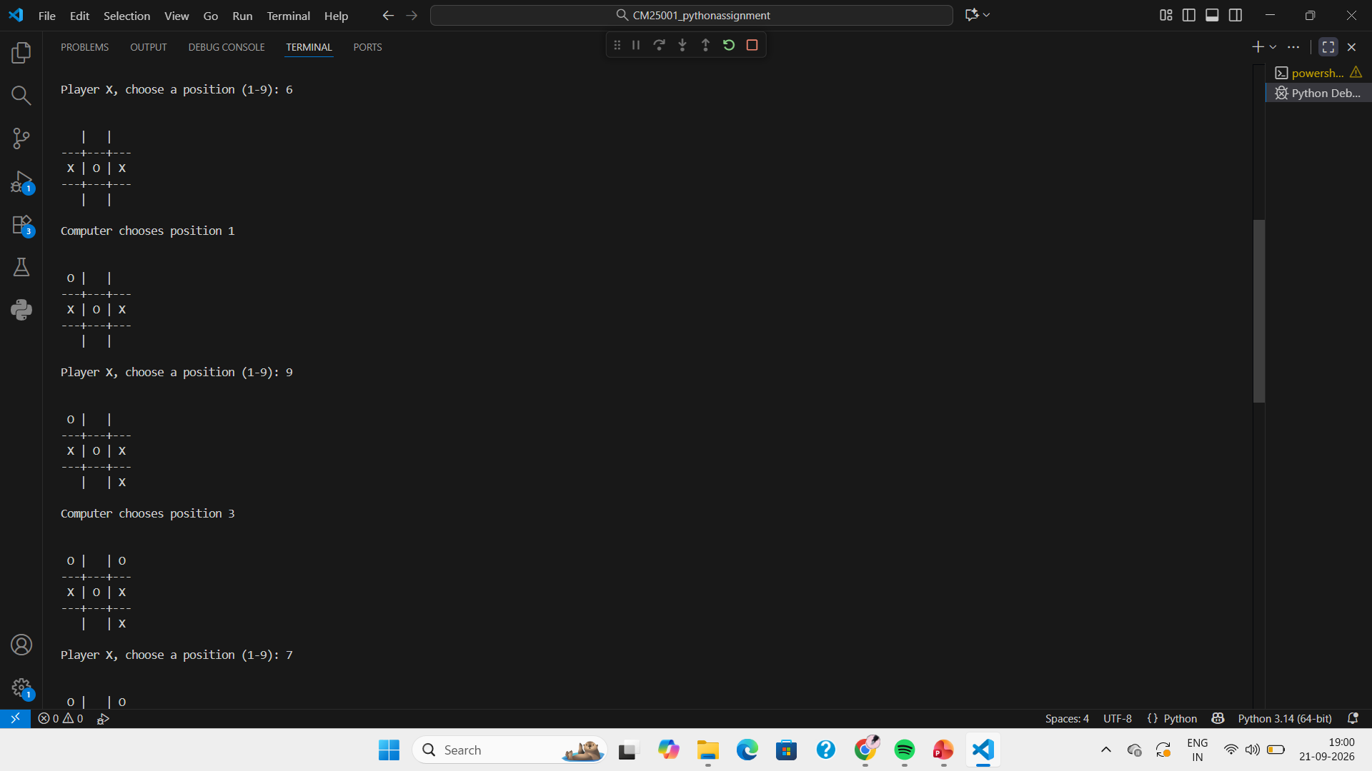
OUTPUT-PHASE-2

Slide 19
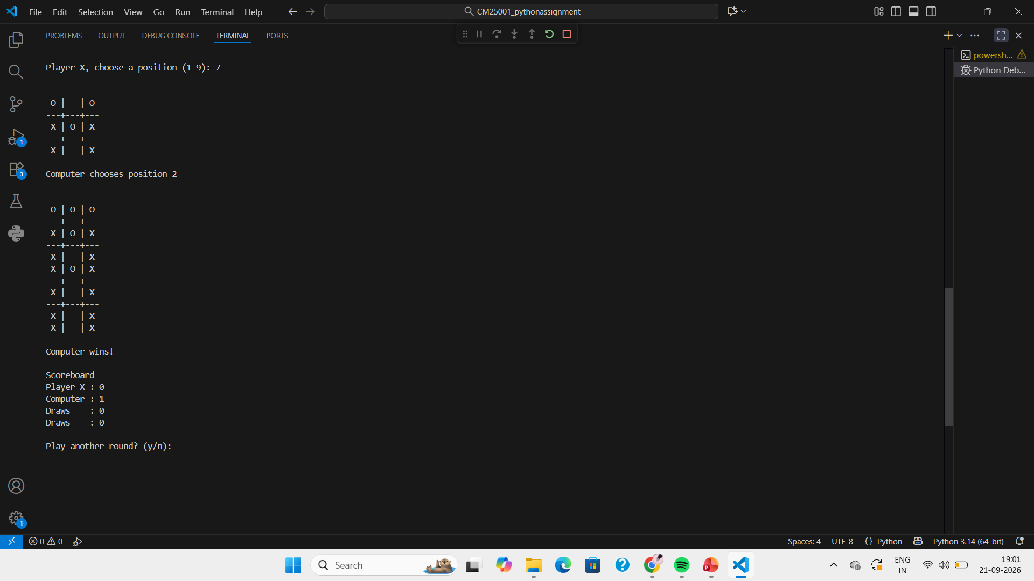
OUTPUT PHASE - 2

Slide 20
UNDERSTANDING PYTHON LOGIC.
Lists: A list is used to store the 9 positions of the Tic Tac Toe board. board = [" "] * 9 creates an empty board.
Tuples: Tuples are used to store all possible winning combinations of rows, columns, and diagonals.
Functions: Functions such as display_board(), check_winner(), get_move(), computer_move(), and play_game() divide the program into smaller and organized tasks.
Conditional Statements: if, elif, and else are used to check valid moves, determine the winner, identify a draw, and select the game mode.
Loops: while loops keep the game running until a winner or draw occurs, while for loops check each winning combination.
Exception Handling: try-except is used to handle invalid user input, such as entering letters instead of numbers, without crashing the program.
Dictionary: A dictionary is used to maintain the scoreboard and store the number of wins for Player X, Player O, and Draws.
Input and Output: input() accepts the player's choice, while print() displays the board, game messages, winner, and scoreboard.
Computer Logic: The computer_move() function makes the computer play strategically by trying to win first, blocking the opponent, choosing the center, and then selecting a corner or free position.

Slide 21
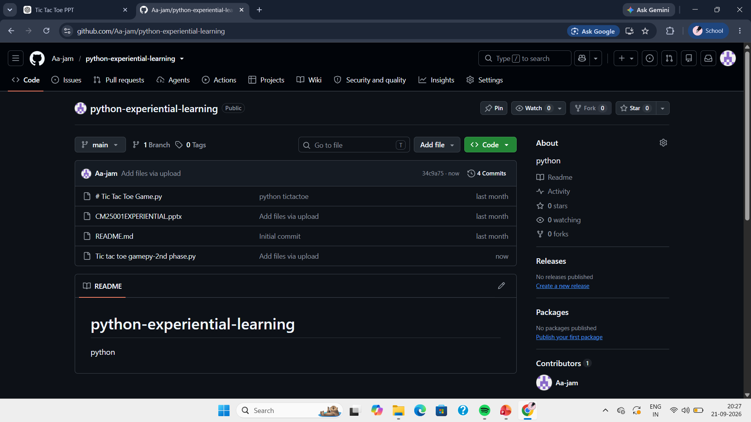
GitHub account, repository creation, uploading code, meaningful commits, collaboration, individual contribution

Slide 22
THANK YOU

